Slide 1


MedScore
UNDERWRITING FDA APPROVAL READINESS USING A PROPRIETARY PREDICTION ANALYSIS ENGINE
An independent, FDA-validated probability score that lets capital price the single biggest binary risk in medtech, unsticking the billions of dollars that die in the valley of death between clinical trials and approval.
SOCIAL IMPACT & SUSTAINABILITY DAYS | AUGUST 2026
TEAM HEALTHCARE 6: Divyam, Nihal, Avihu, Kofi
Notes:
9:30am
Introduce myself
Thank you all for being here
- This is the 13th annual Social Impact & Sustainability Days
- Started in 2013
- That’s one of so many signals that will let you know that social impact and sustainability are part of the fabric and ethos of Kellogg
- In fact, Kellogg started teaching nonprofit leadership as a management discipline in the 1970s, corporate responsibility in the 1990s, social entrepreneurship in the early 2000s, and sustainable finance in 2010.
We’ve been here.
- Now you’re here and you get to benefit not only from the rich curriculum and depth of knowledge and programs inside these walls
- You ALSO get to benefit from learning from and with one another
- Many of you will have chosen Kellogg knowing that we’re team and collaboration oriented
These two days will throw you into the deep end as we put you on what might be your first Kellogg student team and challenge you to do very cool things in an exceedingly short period of time

Slide 2
THE PROBLEM
Capital is available before and after the FDA gate, but not during it
3,000-3,600
~30-50
$7.5-8.7B
~60%
510(k) clearances a year at CDRH
original PMAs a year, trial-gated
US medtech VC deployed a year
of dollars to the top 10% of deals
WHY THE MONEY DIES
WHY NO ONE ELSE WILL SOLVE IT
Seed capital is available. Early R&D gets funded, and capital returns in force once a device is approved.
Trials are where funding dries up. The 3 to 4 year clinical stage has no natural capital provider.
Founders abandon or fire-sale. Assets go to Abbott, Medtronic or Boston Scientific at a discount because approval risk cannot be priced.
No public dataset. The predictive signal sits inside the FDA and in sponsor files.
The FDA has no mandate. Its job is to judge devices, not to route capital.
No credible incumbent. Self-scored devicemakers always pass; a single VC is not neutral.
Sources: FDA / CDRH submission data; HSBC Innovation Banking 2024; PitchBook, 12 months to June 2025.

Slide 3
THE THESIS
Score the binary risk, and capital can fund the stage that currently starves
1
2
3
4
5
CLINICAL TRIALS NEED CASH
THE RISK IS BINARY
UNDERWRITING ENGINE
INSTITUTIONS PAY FOR ACCESS
FDA SHARES THE REVENUE
Initial development is done. The next gate is a 3 to 4 year trial programme that needs funding.
Approval or nothing. Generalist capital cannot price a lumpy, specialist gate, so it stays out.
MedScore returns a calibrated probability of FDA approval plus the rubric behind it.
Funds and lenders subscribe, Bloomberg style, and underwrite upside they used to pass on.
Data stays on premise and the FDA retains ownership, earning a cut that funds review capacity.
The loop: every scored submission adds a labelled outcome, which sharpens calibration, which pulls in more capital and more applicants.
Not-for-profit data utility. The FDA retains ownership of all underlying data and shares subscription revenue; MedScore never owns it.

Slide 4
THE GTM
An independent, calibrated approval-probability score, trained on FDA data that never leaves the FDA
Best case scenario
FDA PARTNERSHIP
Data stays on premise at the FDA. We do not own it.
Model trains inside FDA-controlled infrastructure. Outputs are a probability and a rubric, never anyone's trial data.
Why the FDA says yes: a pre-screen cuts CDRH workload at zero cost.
Risk: no sole-sourcing, so we design to win a competitive RFP.
Fall back option
CONSENT AND PUBLIC DATA
Public data as labels: PMA summaries, De Novo and 510(k) decisions, panel materials, ClinicalTrials.gov, MAUDE.
Consenting applicants share submissions in exchange for a score.
Same bootstrap path credit bureaus used. Needs no one's permission.
TRUST & MOAT
Published calibration: 60% scores approve about 60% of the time, back-tested on public decisions.
Flywheel: more applicants, more labelled outcomes, sharper score, more credibility with capital.

Slide 5
BUSINESS MODEL & REVENUE
Financial institutions pay for access; innovators are scored for free
WHO PAYS
REVENUE LINES
PRICING ANCHOR
Medtech VC, growth equity and PE
Venture debt and specialty credit
Crossover and hedge funds
Corporate venture and M&A teams
Bank healthcare coverage groups
Reinsurers and specialty insurers
Subscription seats. Per-seat access to scores, benchmarks and pipeline analytics.
Diligence reports. Deal-specific scores pulled during due diligence.
Data and API licensing. Scores feeding funds' internal models.
Benchmarking. Approval rates by device class and time to decision.
Bloomberg comp: about $32k per seat a year, 325k to 355k seats.
MedScore seat: $25k to $100k a year, given deal-level ROI.
Illustrative: 300 seats at $50k is about $15M ARR, before reports and licensing.
Non-profit and paid access is not a contradiction: the structure protects neutrality and the FDA relationship. Fees fund operations and R&D. We never sell the model, and the data never leaves the FDA.

Slide 6
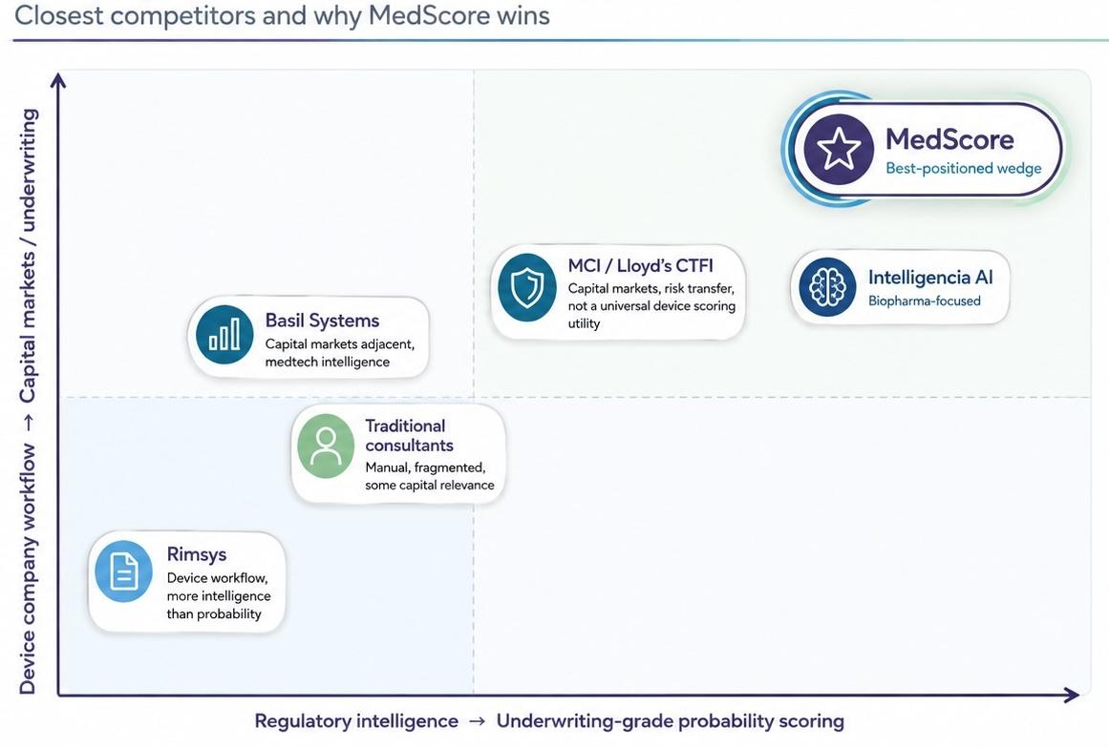
SCALE & IMPACT
A rating agency and data terminal for a vertical that has neither
Peers: No direct peers focusing on med-tech/devices
PATIENTS REACHED
MORE INNOVATION SURVIVES
A MORE EFFICIENT FDA
Devices in the gap treat cardiology, neurology and diabetes. Faster approval pulls care forward for millions.
Fewer devices abandoned or fire-sold. Founders keep ownership and raise at fairer valuations.
A pre-screen frees a CDRH down 180 staff to focus on borderline cases.

Slide 7
APPENDIX: KEY STATS
Secondary research, retrieved August 2026, rounded conservatively
TOPIC | KEY FIGURES AND SOURCE
FDA volumes | ~3,052 510(k) clearances in 2024; ~30 to 50 original PMAs a year. MD+DI / BTIG
CDRH capacity | ~2,260 staff with ~180 cut in early 2025; 3,934 recalls FY2020 to 24. GAO-26-107619; FDA.gov
Medtech VC | $7.5B across 421 deals in 2024, up from $6.5B; top 10% of deals take ~60% of dollars. HSBC
VC momentum | ~$8.7B for the 12 months to June 2025, up 20%; Q1 2025 M&A above $9.2B. PitchBook; EY
Bloomberg Terminal | ~$32k per seat a year; 325k to 355k seats; ~$10B to $13B revenue. Bloomberg; NeuGroup
Rating agencies | ~$12.3B market in 2024 rising to ~$20.9B by 2035; Moody's $7.1B revenue FY2024. Market Research Future

